Slide 1
------------
Topic: You Only Look once
Presented by: Faiza Khan

Slide 2
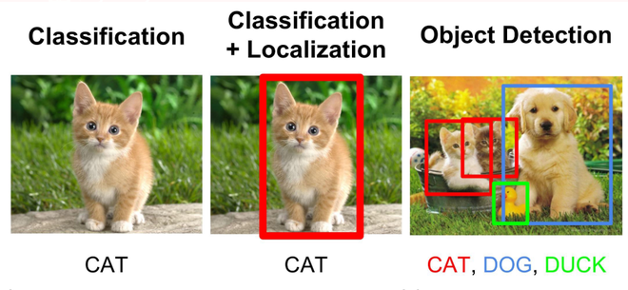
Why we need object detection

Slide 3
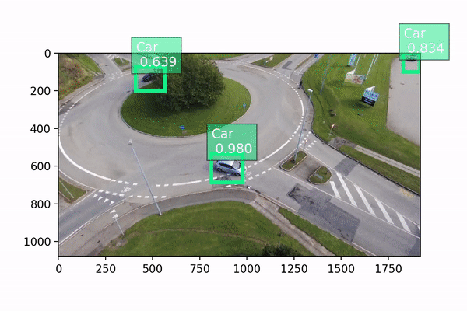
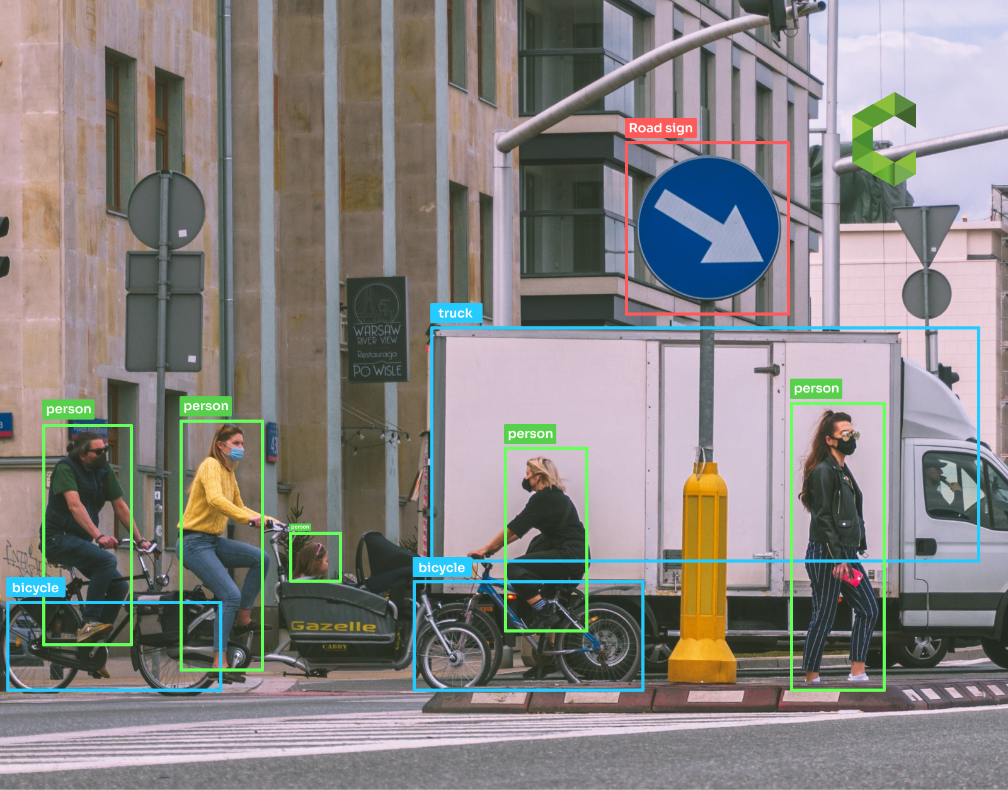
You Only Look Once (YOLO)
YOLO Object detection is a technique used in computer vision for the identification and localization of objects within an image or a video. It is the most popular neural networks, created in 2015 by Joseph Redmon. It is an important part of many applications, such as self-driving cars, robots, medical, and agriculture.

Slide 4
What Makes YOLO Popular for Object Detection?
Speed
Detection accuracy
Good generalization
Open-source

Slide 5
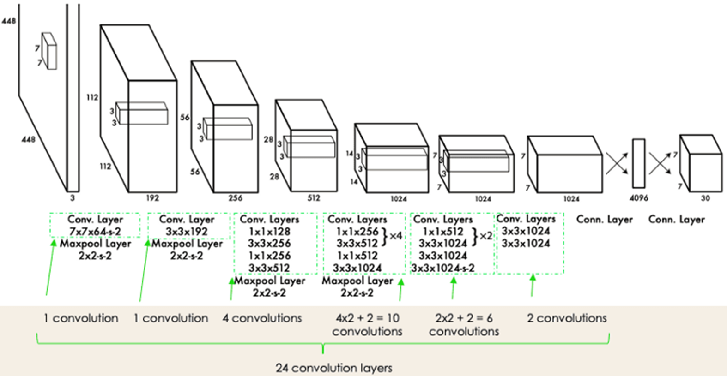
YOLO Architecture
YOLO proposes using an end-to-end neural network that makes predictions of bounding boxes and class probabilities all at once.

Slide 6
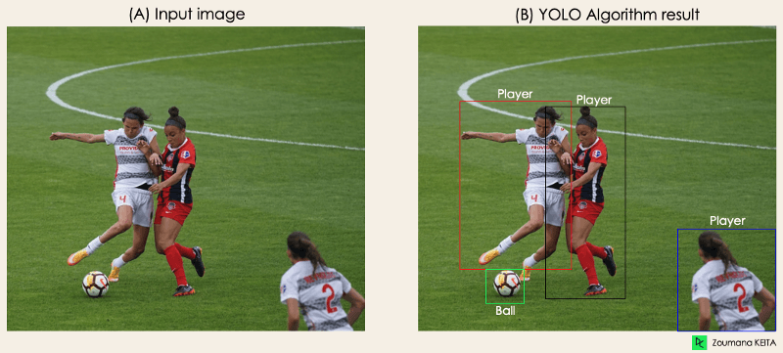
How YOLO works?
Scenario: Imagine you built a YOLO application that detects players and soccer balls from a given image

Slide 7
Cont.
The algorithm works based on the following four approaches:
Residual blocks
Bounding box regression
Intersection Over Unions or IOU for short
Non-Maximum Suppression.

Slide 8
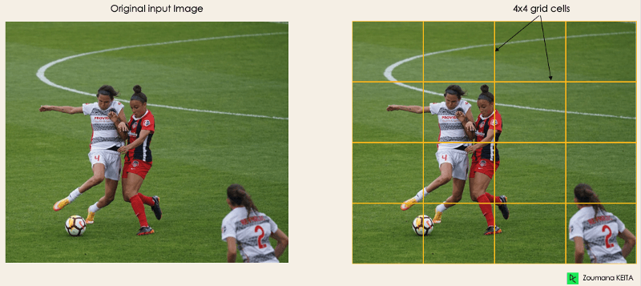
1- Residual blocks
This first step starts by dividing the original image (A) into NxN grid cells of equal shape, where N in our case is 4 shown on the image on the right. Each cell in the grid is responsible for localizing and predicting the class of the object that it covers, along with the probability/confidence value.
(A)
(B)

Slide 9
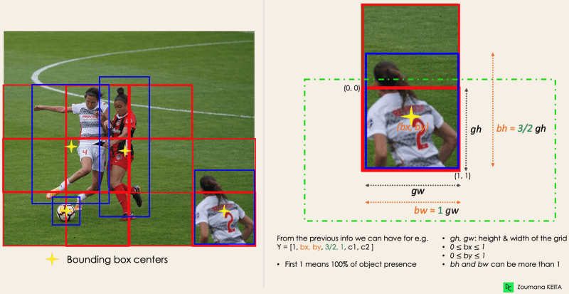
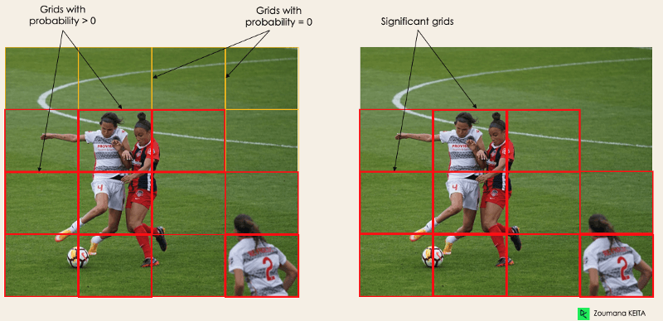
2- Bounding box regression
The next step is to determine the bounding boxes which correspond to rectangles highlighting all the objects in the image. We can have as many bounding boxes as there are objects within a given image.
YOLO determines the attributes of these bounding boxes using a single regression module in the following format, where Y is the final vector representation for each bounding box.
Y = [pc, bx, by, bh, bw, c1, c2]
Notes:
This is especially important during the training phase of the model.
pc corresponds to the probability score of the grid containing an object. For instance, all the grids in red will have a probability score higher than zero. The image on the right is the simplified version since the probability of each yellow cell is zero (insignificant).
Bx, by are the x and y center of the bounding box.
Bh, bw are the height and width f the bounding box.
C1, c2 are the 2 classes (Player, Soccer ball)

Slide 10

3- Intersection Over Unions or IOU

Slide 11
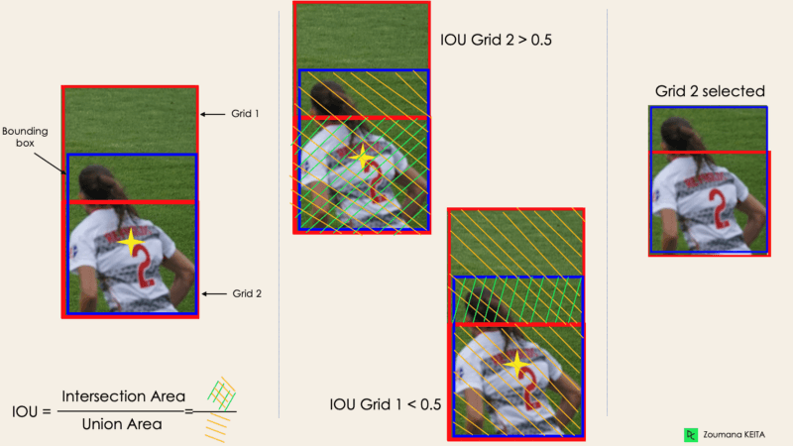
Selecting best Grid for Prediction
Notes:
Most of the time, a single object in an image can have multiple grid box candidates for prediction, even though not all of them are relevant. The goal of the IOU (a value between 0 and 1) is to discard such grid boxes to only keep those that are relevant. Here is the logic behind it:
The user defines its IOU selection threshold, which can be, for instance, 0.5.
Then YOLO computes the IOU of each grid cell which is the Intersection area divided by the Union Area.
Finally, it ignores the prediction of the grid cells having an IOU ≤ threshold and considers those with an IOU > threshold.
Below is an illustration of applying the grid selection process to the bottom left object. We can observe that the object originally had two grid candidates, then only “Grid 2” was selected at the end.

Slide 12
4- Non-Max Suppression or NMS
Setting a threshold for the IOU is not always enough because an object can have multiple boxes with IOU beyond the threshold, and leaving all those boxes might include noise. Here is where we can use NMS to keep only the boxes with the highest probability score of detection.

Slide 13
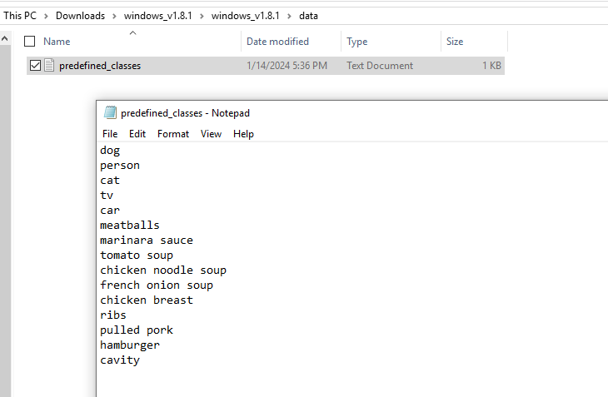
Download the labelImg tool for data annotation “Link in the notes”
Your custom class names comes here.
Notes:
https://github.com/tzutalin/labelImg/files/2638199/windows_v1.8.1.zip

Slide 14
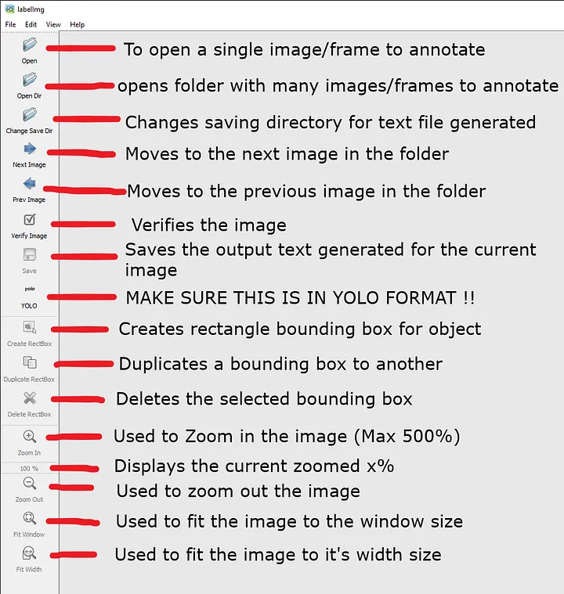

Slide 15
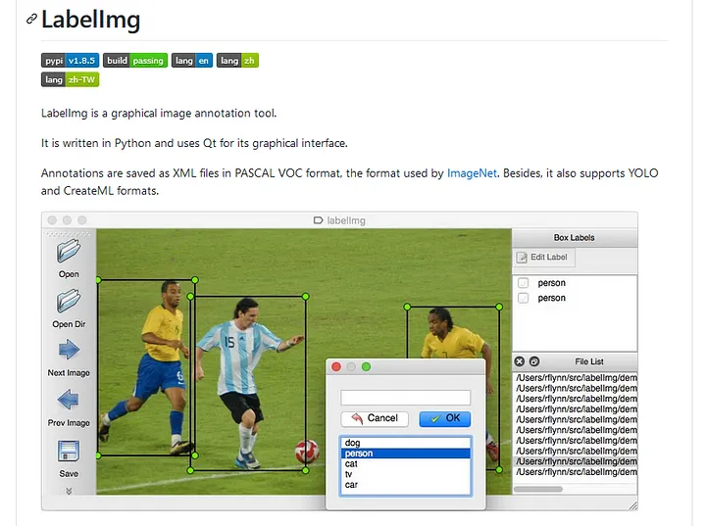
Image annotation

Slide 16
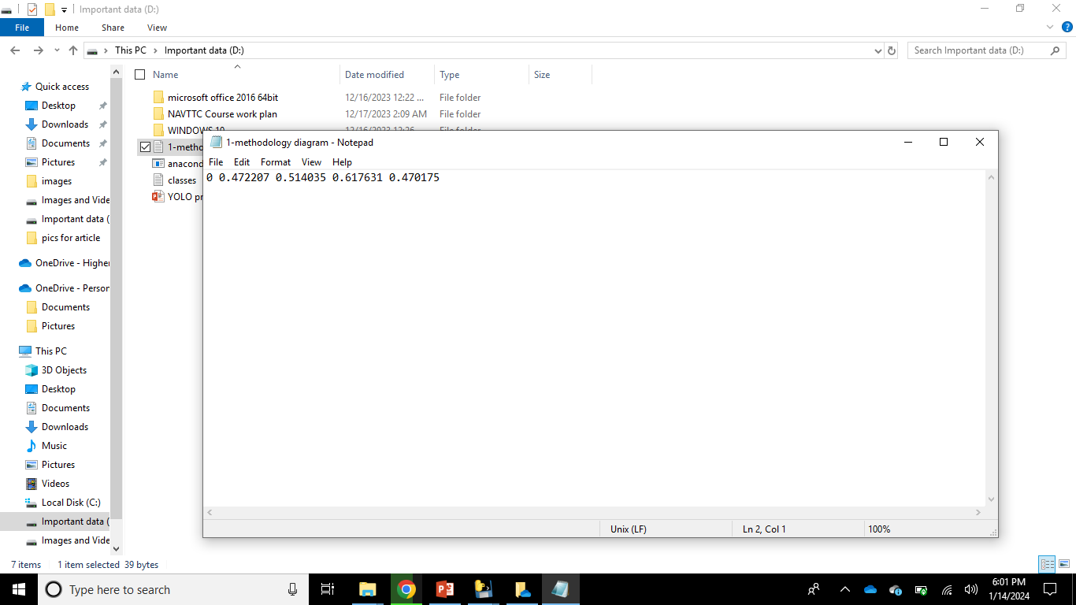
Text file after labeling
Class id, x_center, y_center, width, and height

Slide 17
Other labeling tools
Labelme
Roboflow
CVAT (computer vision annotation tool)
VoTT (Visual Object Tagging Tool)
imglab

Slide 18
Dataset splitting ratio
Train 70%, 80%
Images
Labels
Val 30%, 20%
Images
Labels

Slide 19
Install Yolov8
!git clone https://github.com/ultralytics/ultralytics.git

Slide 20
Creating .yaml file
Why? — Yolo itself does not know where our train images are and where our validation images are. Therefore, we convey this vital information to Yolo by means of the .yaml file. The content of this file gives the location of our train and val folders along with class information and it looks something like this:
train: /train/images val: /val/images nc: 1 names: [‘your class name 1‘, ‘your class name 2’]

Slide 21

Training the Yolov8 model

Slide 22
Important parameters
Task: Whether we want to detect, segment, or classify on the dataset of our choice.
Mode: Mode can either be train, val, or predict. As we are running training, it should be train.
Model: The model that we want to use. Here, we use the YOLOv8 Nano model pretrained on the COCO dataset.
imgsz: The image size. The default resolution is 640.
Data: Path to the dataset YAML file.
Epochs: Number of epochs we want to train for.
Batch: The batch size for data loader. You may increase or decrease it according to your GPU memory availability.
Name: Name of the results directory for runs/detect.

Slide 23
For yolov8 model training
To get the best model, we need to conduct several training experiments and evaluate each. As such, we will train three different YOLOv8 models:
YOLOv8n (Nano model)
YOLOv8s (Small model)
YOLOv8m (Medium model)

Slide 24
Custom training Yolov8
!yolo task=detect/classify/segment
mode=train/predict/val/export
model=yolov8n.pt/yolov8s.pt/yolov8m.pt
data=/content/drive/MyDrive/dataset/custom.yaml.
epochs=100
Imgsz=416/640/…..(multiple of 32)
!yolo task=detect mode=train model=yolov8n.pt data=/content/drive/MyDrive/dataset/custom.yaml epochs=100 imgsz=416

Slide 25
Validate custom model
!yolo task=detect
mode=val
model=/content/drive/MyDrive/yolov8/datasets/runs/detect/train1/weights/best.pt
data=/content/drive/MyDrive/yolov8/ultralytics/ultralytics/datasets/custom.yaml
!yolo task=segment mode=val model=/content/drive/MyDrive/yolov8/datasets/runs/detect/train1/weights/best.pt data=/content/drive/MyDrive/yolov8/ultralytics/ultralytics/datasets/custom.yaml

Slide 26
Inference using the Trained YOLOv8 Model
!yolo task=detect
mode=predict
model=/content/drive/MyDrive/yolov8/datasets/runs/detect/train1/weights/best.pt
conf=0.50
source=/content/drive/MyDrive/yolov8/datasets/camA_1430.jpg
save=true
!yolo task=detect mode=predict model=/content/drive/MyDrive/yolov8/datasets/runs/detect/train1/weights/best.pt conf=0.50 source=/content/drive/MyDrive/yolov8/datasets/camA_1430.jpg save=true

Slide 27
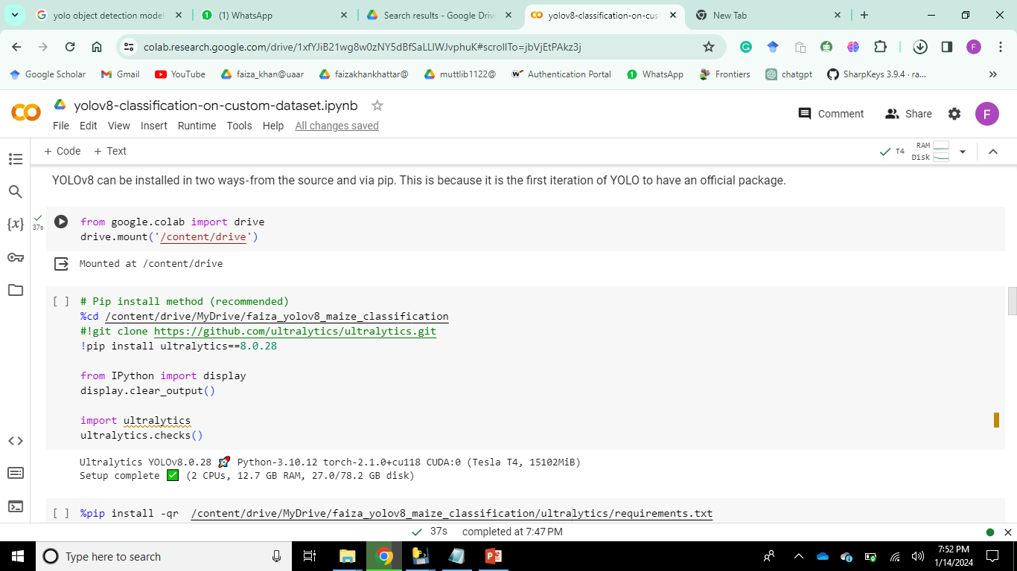

Slide 28
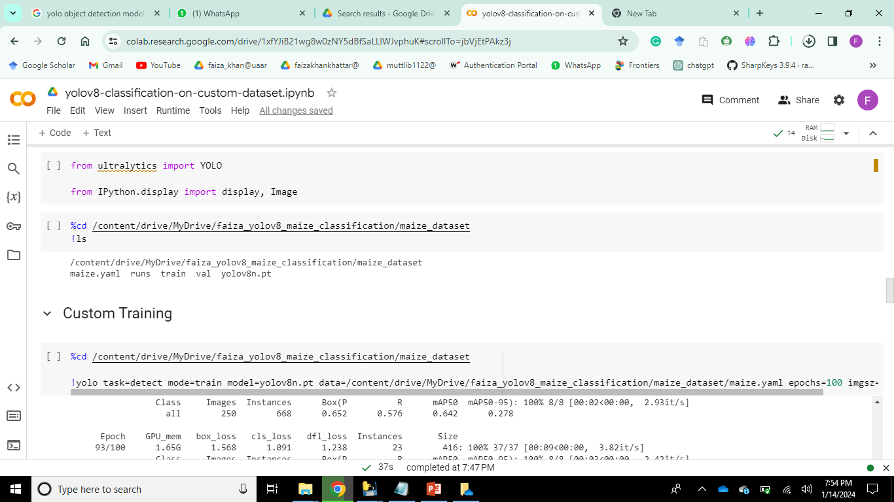

Slide 29
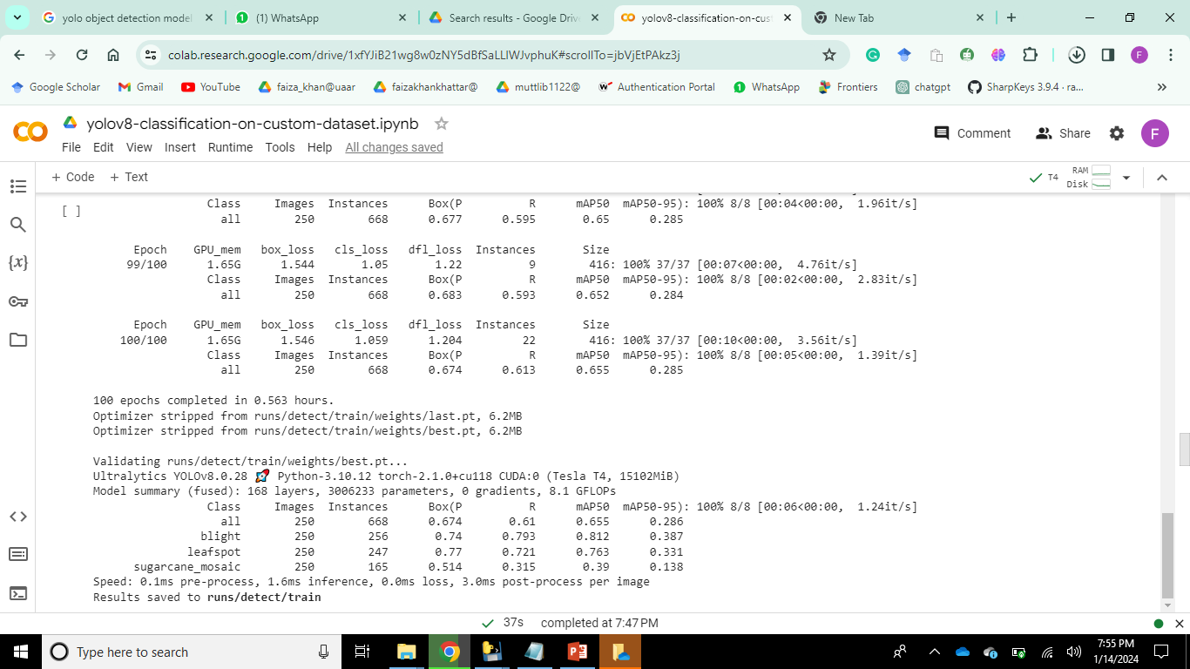

Slide 30
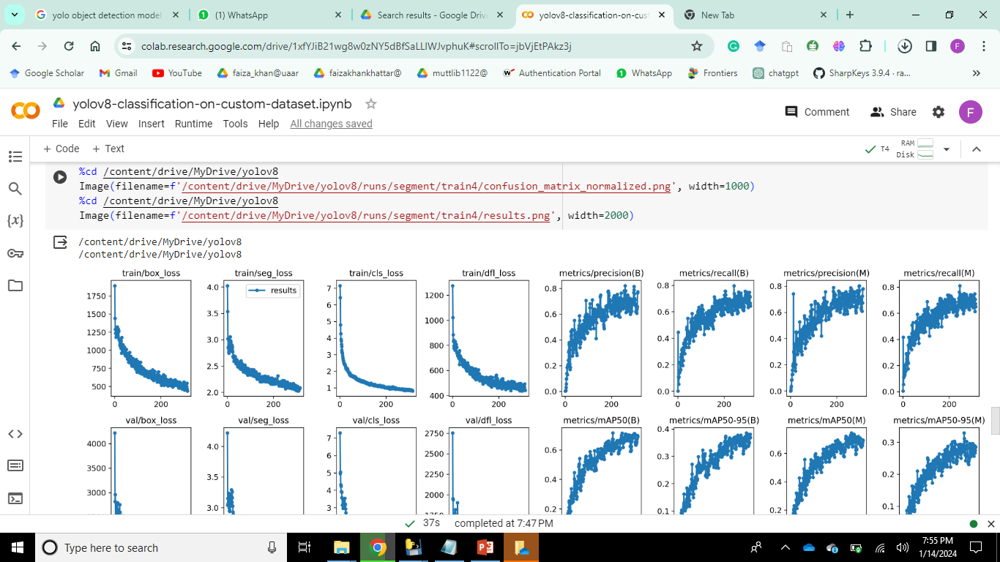

Slide 31
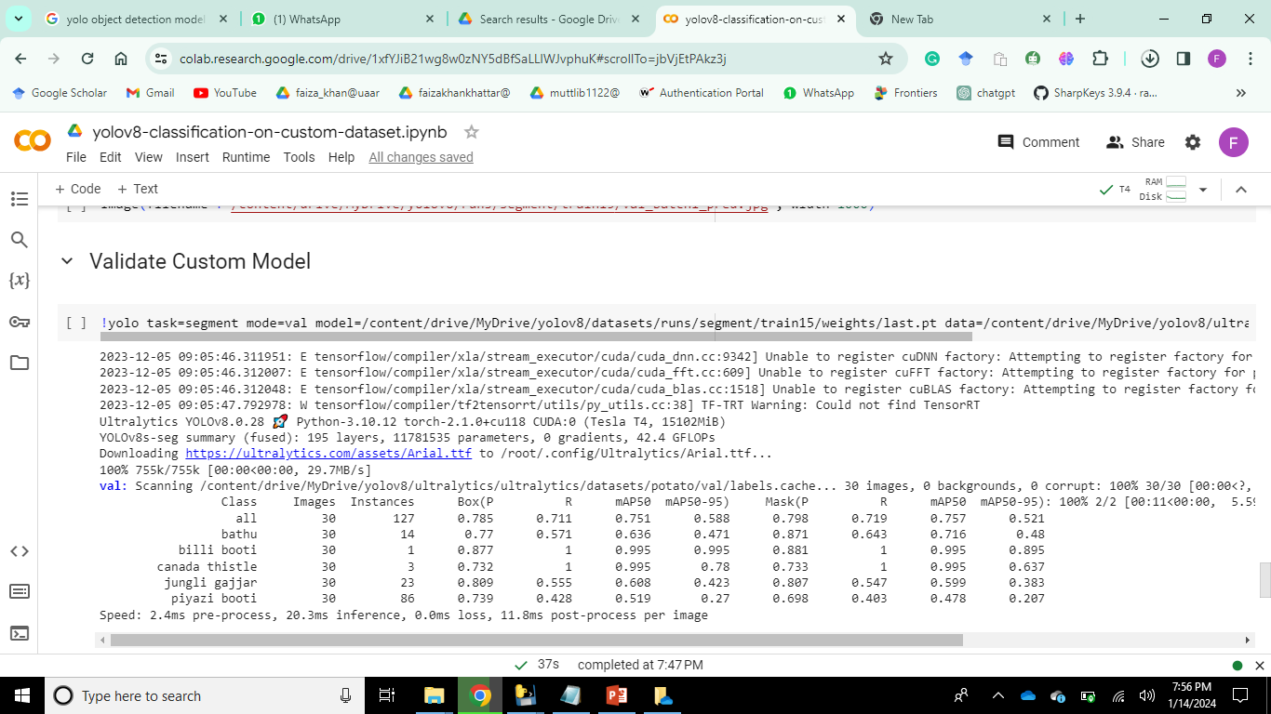

Slide 32
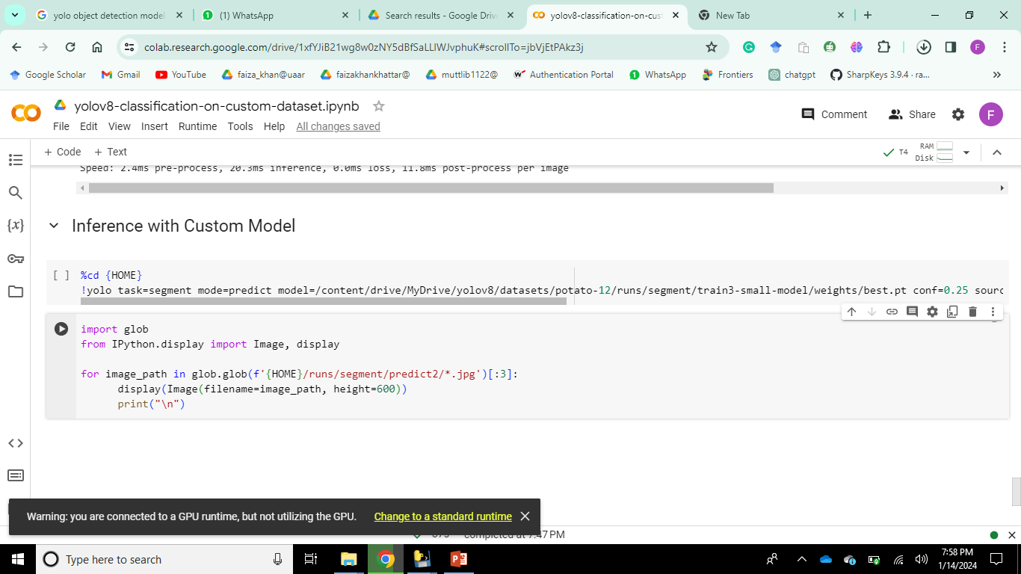

Slide 33
Detection results

Slide 34


